Slide 1

CoviDoc
Smart assistant to ease the process
Of C0VID-19 and Pneumonia detection
Project ID-2021-180

Slide 2
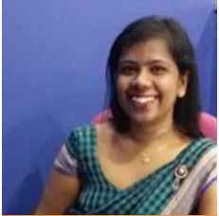
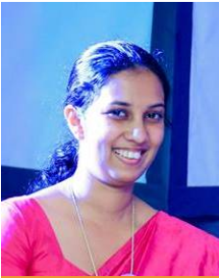

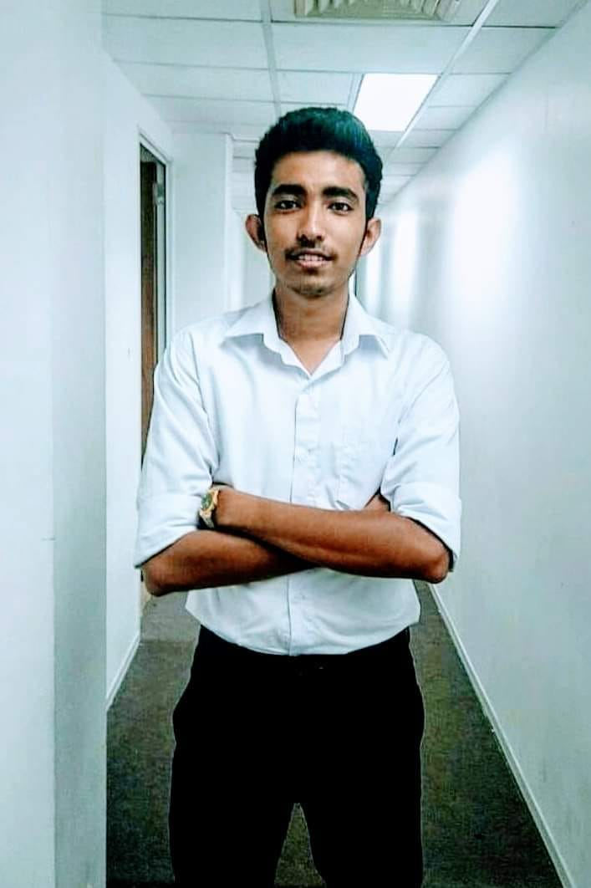
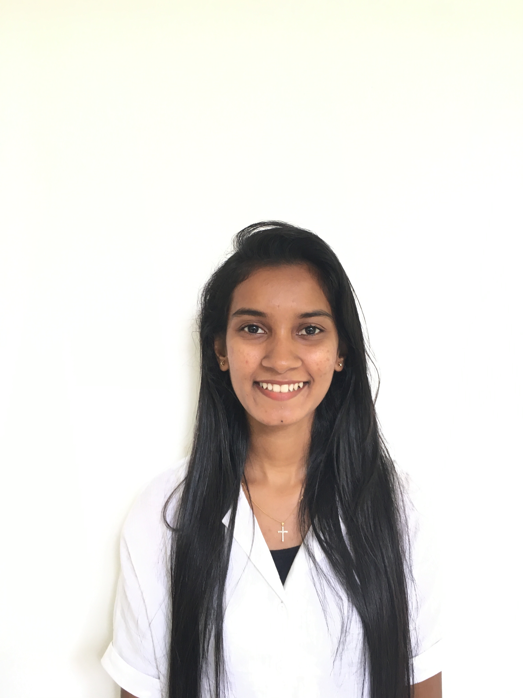
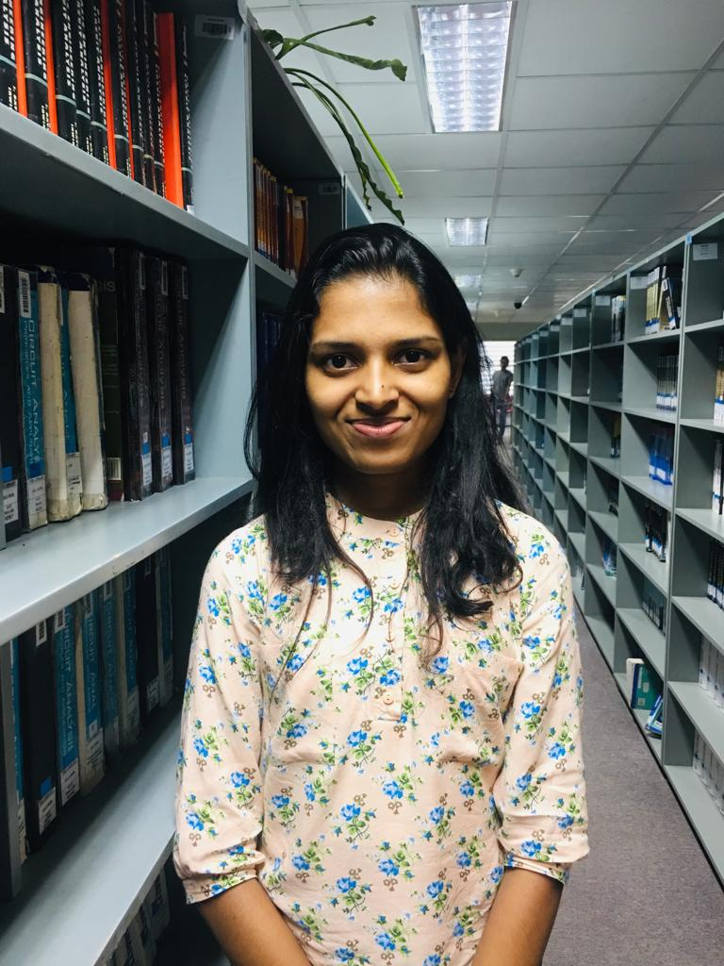
Meet Our Team
Supervisor
Co-Supervisor
Mrs. Bhagyanie Chathurika
MS. Chamari Silva
Akalanka B.A
Nimantha W.A.R
Dias M.H.V
Senevirathne K.D.A

Slide 3

INTRODUCTION
WHY ARE WE DOING THIS PROJECT?
SUGGESTED SOULTION

Slide 4
Overall Project Description
X-ray Image Analysis
CT Scan Image Analysis
Breathing-hold Time Analysis
Accurate diagnose of Pneumonia ,COVID-19 Pneumonia and by analyzing
Chest X-ray mages
Health History Tracker
Accurate diagnose of COVID-19 Pneumonia by analyzing
Chest CT scan images
Symptom
Tracker
Draw out the information about the patient’s breath-holding time information and predict the risk level .
Draw out the information about the patient’s health history related information and predict the risk level .
Draw out the information about the patient’s current symptoms and predict the risk level .

Slide 5
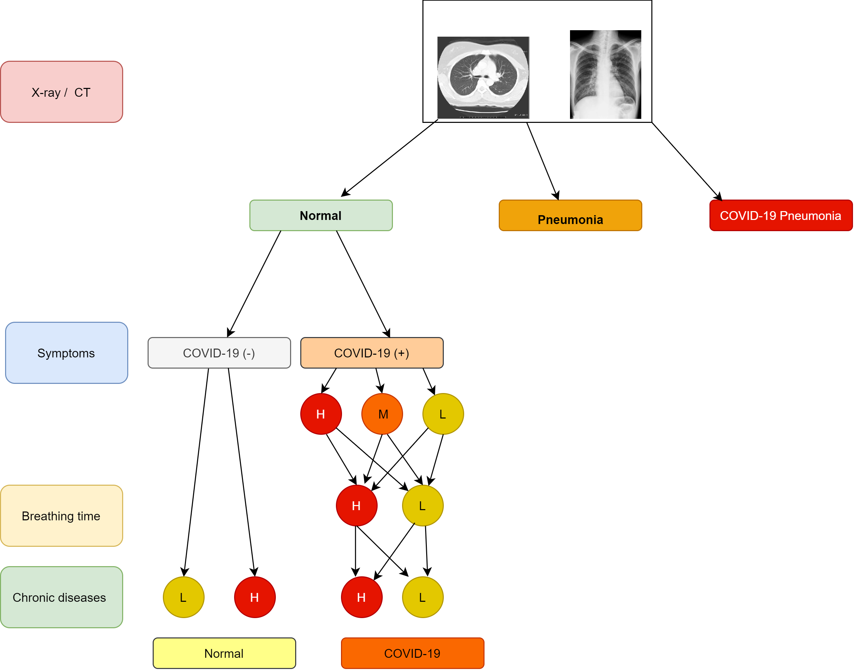
SYSTEM OVERVIEW

Slide 6
COMMERCIALIZATION
Social media platforms
01
Advertise the app to the public through social media platforms.
Cost-efficient marketing method.
02
High reliability helps commercialization
Results are monitored by a physician and validated.
Increases the reliability of the mobile application.
03
Inexpensive easy method
Very easy to use by people in any age group.

Slide 7

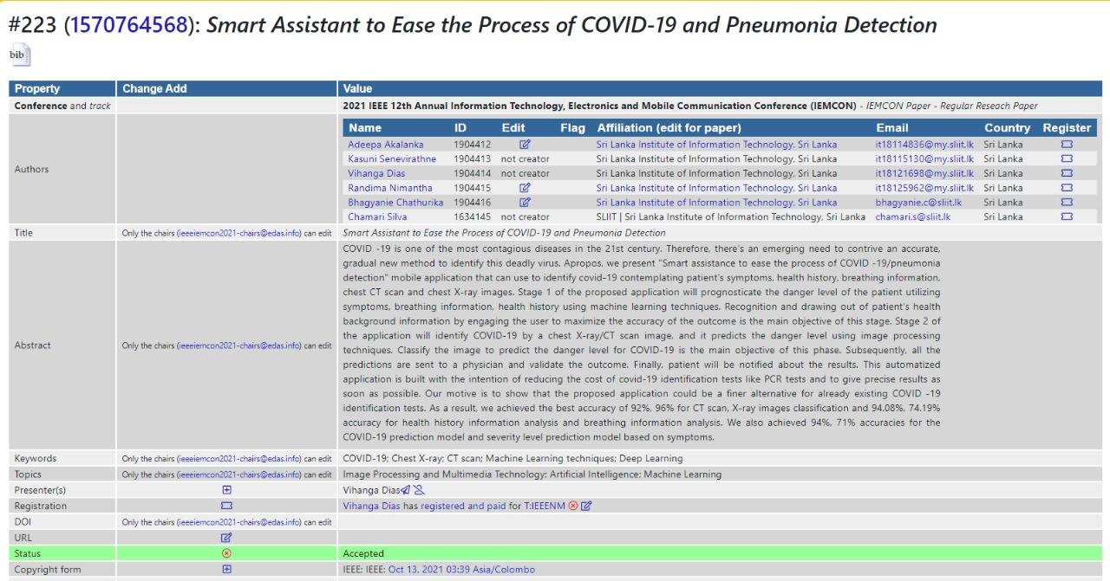
ACHIVEMENTS
RESEARCH PAPER WAS SELECTED TO PUBLISH ON
IEEE IEMCON 2021
CONFERENCE
H-INDEX
22

Slide 8
Component-1
Senevirathne K.D.A
IT18115130
Accurate diagnosis of Covid Pneumonia and Pneumonia by using Chest X-ray images

Slide 9
Problem
PCR Test requires specific material and equipments
Patient must wait for long time to get their PCR test reports
PCR Testing is not available in most medical centers
This delay of identifying COVID-19 lead to highly transmit the virus among people
Solution
Develop a useable mobile app to give a result whether he or she suffering from Covid-19 or Pneumonia or not by evaluating chest X-rays
IT18115130|Senevirathne K.D.A | 2021-180

Slide 10
METHODOLOGY
Libraries
Architectures
Pandas - use for data analysis
VGG16 - 96%
Numpy - use for mathematical operations
Densenet169 - 92%
Matplotlib - use for data visualization
Keras - use for model building and training

Slide 11
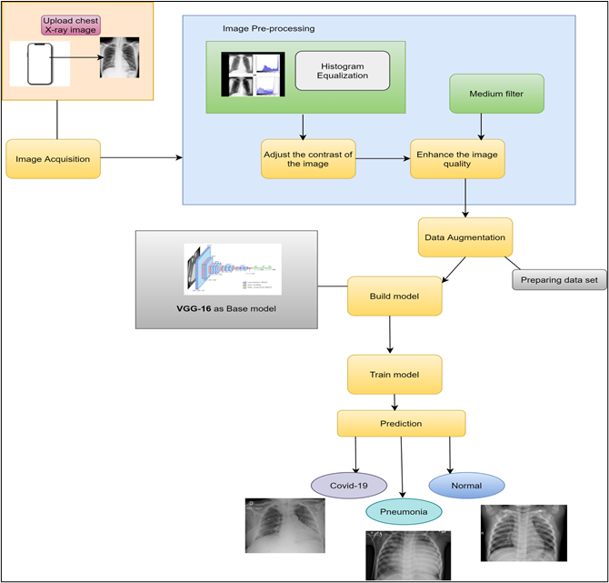
System Overview Diagram

Slide 12
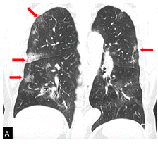
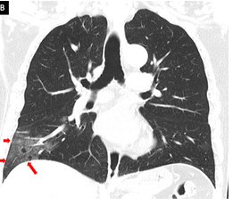
Key features of chest X-ray images

Slide 13


Front-end
React Native
API
Flask API
Back-end
Python

Slide 14
COMPLETION OF THE PROJECT
10%
Some testing parts
Some front-end development parts
90%
Implemented mobile app front end
Finalized model and create API to connect Mobile app with the model
50%
Collect Dataset and image pre-processing
Trained the models and select the best accuracy
Designed prototypes
Proposal Presentation
IT18115130|Senevirathne K.D.A | 2021-180

Slide 15
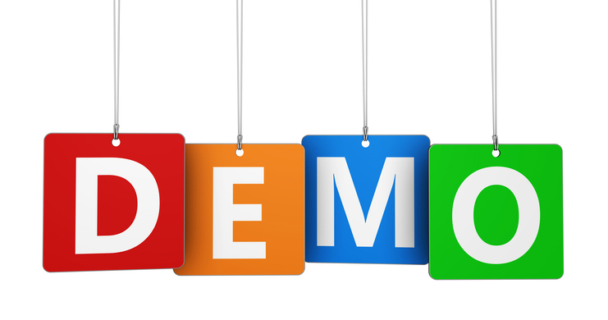

Slide 16
Component-2
Akalanka B.A
IT18114836
Accurate diagnosis of Covid-19 using Chest CT Scan images

Slide 17
Problem
Covid -19 is spreading and millions of people are dying
Patient must wait for long time to get their PCR test reports
Shortage of PCR testing equipment
Solution
Develop a useable mobile app to give a result whether he or she suffering from Covid-19 or not by evaluating chest CT images
IT18114836|Akalanka B.A | 2021-180

Slide 18
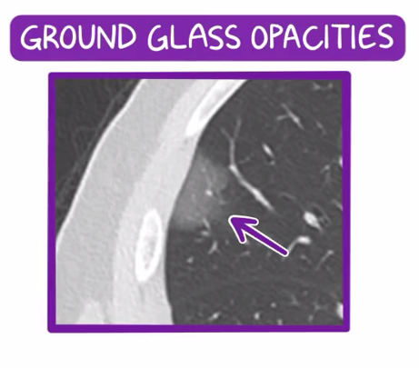
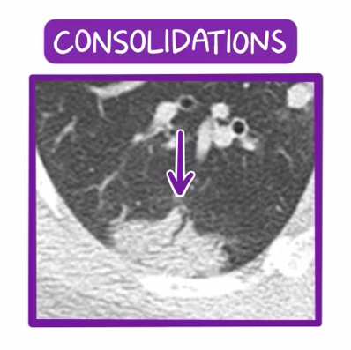
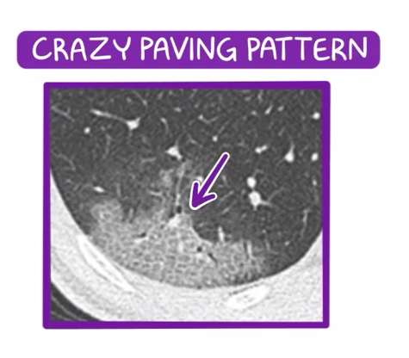
Key features of chest CT images

Slide 19
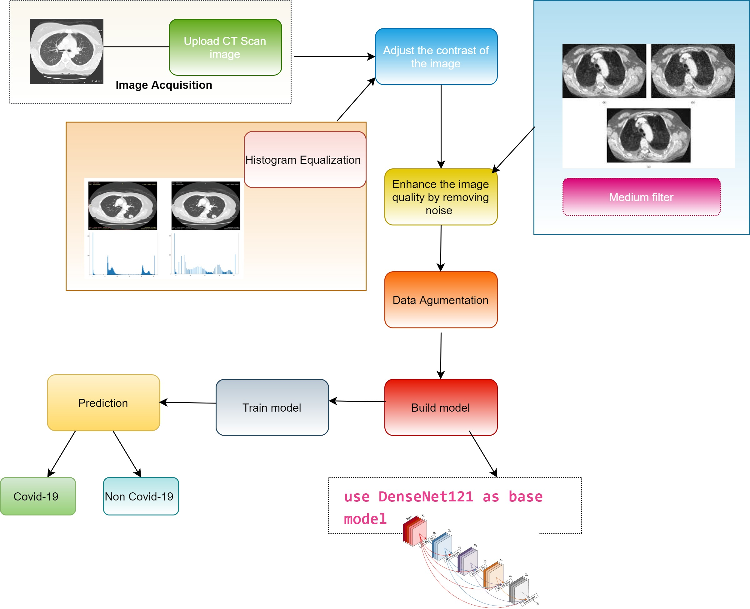
System Overview
Dataset – 2500 Chest CT scan images
Kaggle – 2000
GitHub repository / From a hospital - 250

Slide 20
Methodology
Libraries
Architectures
Densenet121 - 92%
Tenserflow
ResNet50 - 84%
Open CV
Keras
VGG16 - 77%

Slide 21
Front-end
React Native
API
Flask API
Back-end
Python

Slide 22
COMPLETION OF THE PROJECT
10%
Some testing parts
Some front-end development parts
90%
Front-end implementation
Connected the model and mobile app using Flask API
50%
Trained the models, selected the best architecture that has the highest accuracy level and got the predictions.
Designed a protype for mobile app.
Proposal Presentation
IT18114836|Akalanka B.A | 2021-180

Slide 24
Component-3
Nimantha W.A.R
IT18125962
Accurate Diagnosis And Predict Risk Level Using Symptoms

Slide 25
Problem
Patient have to wait for a long period to get the results of PCR tests.
No any mobile application that predict covid-19 risk level and covid-19 using symptoms.
Solution
Develop a useable mobile app to predict risk level for COVID-19 analysing patient’s symptoms
IT181125962|Nimantha W.A.R | 2021-180

Slide 26
Methodology
Libraries
Algorithms
Numpy- use for mathematical operations
pandas- use for data analysis
Seaborn - use for data analysis
matplotlib- use for data analysis
Random Forest Algorithm.
Decision Tree Algorithm.
Linear Regression Algorithm.
K-Nearest Neighours

Slide 27
Front-end
React Native
API
Flask API
Back-end
Python

Slide 28
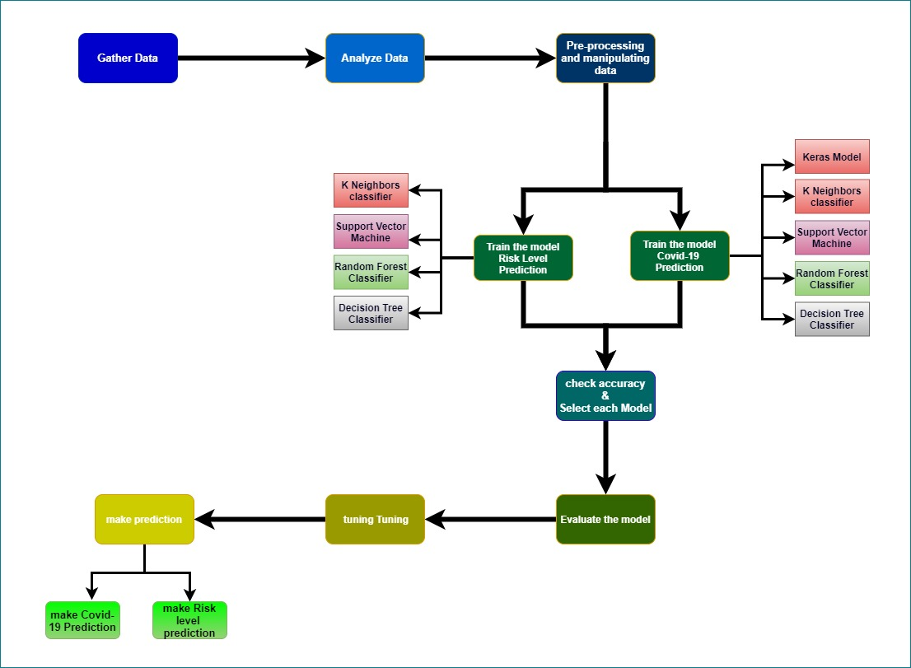
System Overview

Slide 29
COMPLETION OF THE PROJECT
10%
Some front-end development parts
.
90%
Front-end implementation
Connected the model and mobile app using Flask API
50%
Trained the models, selected the best architecture that has the highest accuracy level and got the predictions.
Designed a protype for mobile app.
Proposal Presentation
IT181125962|Nimantha W.A.R | 2021-180

Slide 31
Component-4
Dias M.H.V
IT18121698
Accurate Diagnosis and Predict Danger Level Using Patient's Health History and Breathing Time

Slide 32
Problem
Patient must wait for long time to get their PCR test reports .
Existing applications do not have risk stratification based on breath-holding time and health history.
PCR Test requires specific material and equipment.
Solution
Develop a useable mobile app to predict danger level for COVID-19 analysing patient’s health history related factors and breath-holding time.
IT18121698|Dias M.H.V | 2021-180

Slide 33
Methodology
Libraries
Algorithms
Numpy- use for mathematical operations
pandas- use for data analysis
Seaborn - use for data analysis
matplotlib- use for data analysis
Random Forest Algorithm.
Health history – 94.08%
Breathing analysis – 74.19%
Decision Tree Algorithm.
Linear Regression Algorithm.

Slide 34
Front-end
React Native
API
Flask API
Back-end
Python

Slide 35
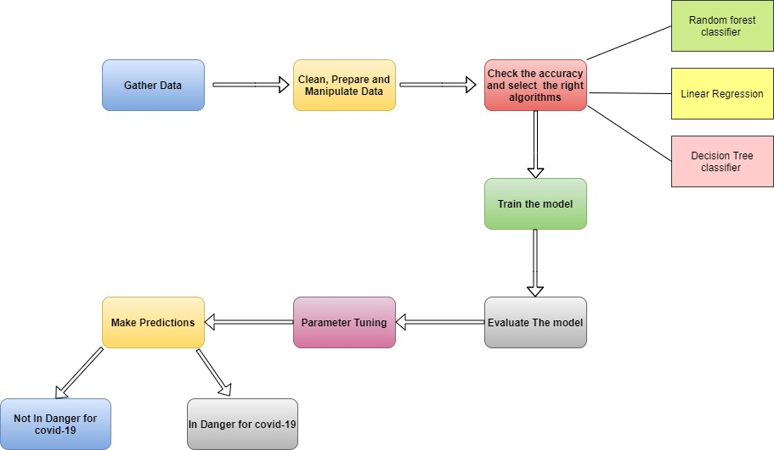
System Overview

Slide 36
COMPLETION OF THE PROJECT
10%
Some testing parts
Some front-end development parts
90%
Front-end implementation
Connected the model and mobile app using Flask API
50%
Trained the models, selected the best model that has the highest accuracy level and got the predictions.
Designed a protype for mobile app.
Proposal Presentation
IT18121698|Dias M.H.V | 2021-180

Slide 38
CoviDoc
THANK YOU
2021-180

